Slide 1


Slide 2
computer programing project

Slide 3
Speaker bureau

Slide 4
PROJECT NAME:
SPEAKER BUREU PROGRAM
SUBMITTED BY:
AZEEMA AZHAR(180916)
MALEEHA REHMAN(180934)
SUBMITTED TO :
SIR MOHSIN ALI

Slide 5
Objective
Learn structure
Use switch statements
Pointer and structure
Array and structure
Function definition

Slide 6
THE PROGRAM WAS Designed/CODED TO GET THE FOLLOWING OUTPUT
The program should store the following data about a speaker:
1. Name
2. Telephone Number
3. Speaking Topic
4. Fee Required

Slide 7
Input Validation:
When the data for a new speaker is entered, be sure the user enters data for all the fields. No negative amounts should be entered for a speaker’s fee.

Slide 8
FOLLOWING POINTS WERE CONSIDERED WHILE CODING THE PROGRAM:
The program should structures to store information of the speaker.
The program should use an array of at least 10 structures. It should let the user enter data into the array, change the contents of any element, and display all the data stored in the array. The program should have a menu-driven user interface.

Slide 9
What are structures?
A structure is a user defined data type in C/C++. A structure creates a data type that can be used to group items of possibly different types into a single type.

Slide 10
Definition:
Struct<struct name>
{ member list};
Instantiate:
<Structure name> <structure tag> ;
Access:
<structure tag> .<member name>

Slide 11
Structure in our code:
Structure name
struct speakerBureau
{
string name;
string TelephoneNumber;
string SpeakTopic;
int fee;
};
Members list

Slide 12
Array and structure used in the code:
Structure name
speakerBureau info[10];
tag

Slide 13
INFO[10]
IN MEMORY
string name;
string TelephoneNumber;
string SpeakTopic;
int fee;
X
10
[0]
[1]
[2]
[3]
[4]
[5]
[6]
[7]
[8]
[9]
string name;
string TelephoneNumber;
string SpeakTopic;
int fee;
string name;
string TelephoneNumber;
string SpeakTopic;
int fee;
string name;
string TelephoneNumber;
string SpeakTopic;
int fee;
string name;
string TelephoneNumber;
string SpeakTopic;
int fee;
string name;
string TelephoneNumber;
string SpeakTopic;
int fee;
string name;
string TelephoneNumber;
string SpeakTopic;
int fee;
string name;
string TelephoneNumber;
string SpeakTopic;
int fee;
string name;
string TelephoneNumber;
string SpeakTopic;
int fee;
string name;
string TelephoneNumber;
string SpeakTopic;
int fee;
string name;
string TelephoneNumber;
string SpeakTopic;
int fee;

Slide 14

Why array of structures is used?
To store information for 10 bureau .
As the information is of same type
(name /topic /fee etc) or we can say of same
structure thus we used an array of
structure of size 10

Slide 15
Function prototype: the prototype declare a function which
void getSpeaker(speakerBureau *); stores speakers info
void printSpeaker(speakerBureau *); print speakers info
void editSpeaker(speakerBureau *); edit speakers info
void searchSpeakTopic(speakerBureau*); search for speaker by topic

Slide 16
Parameter is pointer:
The * (dereferencing operator) here shows that it is pointing towards the location of structure.
void getSpeaker(speakerBureau *);
parameter.

Slide 17

why pointers?
We know that pointers are used as third party.
In our code pointers help us to save the data of the speakers and then it let us to change it later..
Note: we won’t go in details of how to use pointers and how they point towards a location as we have done that in the lab.

Slide 18

How our code use pointers?
void getSpeaker(speakerBureau *p) //array name = pointer
{
int i = 0;
int size = 10;
for (i = 0; i < size; i++)
{
cout << "Please enter the following information of speaker " << i << " : \n";
cout << "Speaker Name:";
cin.ignore();
getline(cin, p[i].name);
cout << "\nSpeaker Telephone Number:";
cin.ignore();
getline(cin, p[i].TelephoneNumber);
cout << "\nSpeaker Topic:";
cin.ignore();
getline(cin, p[i].SpeakTopic);
cout << "\nFee Required:";
cin >> p[i].fee;
}
}
This pointer which is an array will basically store information of 10 speakers in the structure INFO.

Slide 19
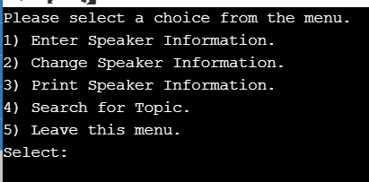
Menu-driven user inference:
Example from our code
output
So we are not going towards the formal definition of the terms. As far menu-driven user is concerned it ask the user to select from the menu displaying different options.

Slide 20
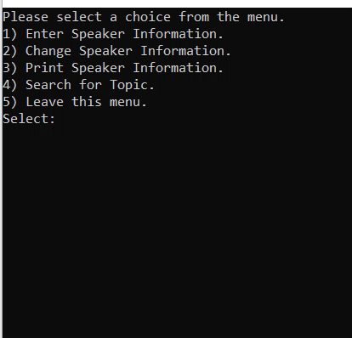
Lets test our code on a user

Slide 21
Lets try it

Slide 22
The end

